Slide 1
Organization of state administration in the field of security

Slide 2
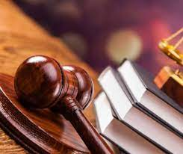
Several subjects play a key role in the organization of public administration in the field of security.
The President of Ukraine as head of state:
• determines the main areas of ensuring the internal and external security of the state;
• carries out general management of state bodies providing security;
• controls and coordinates the activities of these bodies;
• forms and heads the National Security and Defense Council of Ukraine;
• within the scope of competence defined by law, makes operational decisions regarding security;
• under the conditions and in the manner prescribed by the Constitution of Ukraine and current legislation, introduces a state of emergency on the territory of Ukraine or in some of its localities with immediate notification to the Verkhovna Rada of Ukraine;
• at least once a year submits a report to the Verkhovna Rada of Ukraine on ensuring the security of Ukraine;
• supervises the activities of the Security Service of Ukraine
The Constitution of Ukraine (Article 107) provides a special place for the Council of National Security and Defense of Ukraine (hereinafter referred to as the National Security and Defense Council), which is a coordinating body for national security and defense issues under the President of Ukraine.

Slide 3
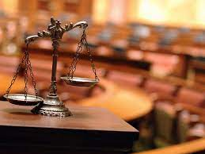
and controls the activities of state authorities, local self-government bodies within the limits of the granted powers during the introduction of martial law or a state of emergency.
The NSDC creates conditions for the President of Ukraine to exercise his constitutional powers to protect the rights and freedoms of man and citizen, to protect the sovereignty of Ukraine, its independence and state integrity. The NSDC examines issues of internal and external policy of Ukraine in the field of security, strategic problems of state, economic, public, defense, informational, economic and other types of security, public health protection, forecasting, prevention of emergency situations and overcoming their consequences, ensuring stability and law and order in the country.
The head of the National Security Council is the President of Ukraine. The staff of the NSDC is formed by the President of Ukraine.
The NSDC develops and considers at its meetings and submits proposals to the President of Ukraine regarding the determination of Ukraine's strategic national interests, conceptual approaches and directions for ensuring national security and defense in various spheres of the state's vital activities, coordinates and carries out ongoing control over the activities of executive authorities, submits relevant conclusions to the President of Ukraine and proposals, coordinates

Slide 4
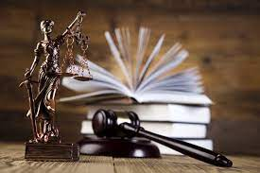
The members of the NSDC ex officio include the Prime Minister of Ukraine, the Minister of Defense of Ukraine, the head of the Security Service of Ukraine, the Minister of Internal Affairs of Ukraine, and the Minister of Foreign Affairs of Ukraine. Its members can also be heads of other central executive bodies.
The Secretary of the National Security Council is appointed and dismissed by the President of Ukraine and reports directly to him.
The legal status of the secretary of the NSDC as a civil servant is determined President of Ukraine in accordance with the Law of Ukraine "On Civil Service".
The secretary of the NSDC ensures the organization of work and the implementation of its decisions, he has deputies who are appointed and dismissed by the President of Ukraine at his request.
The National Security and Defense Council of Ukraine: determines the vital interests of the individual, society and the state, identifies internal and external threats to security objects; develops the main directions of the strategy for ensuring the security of Ukraine, organizes the preparation of programs for its security;
Meetings of the National Security Council are held at least once a month. If necessary, extraordinary meetings can be held. Permanent members of the National Security Council have equal rights when making decisions. Members of the National Security Council participate in its work with the right of an advisory vote.

Slide 5
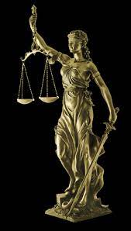
Decisions of the National Security Council on the most important issues are formalized by decrees of the President of Ukraine, other decisions by protocols. In terms of ensuring state security, the Security Service of Ukraine (hereinafter referred to as the SBU) plays a key role, the foundations of its organization and activities are enshrined in the Law of Ukraine "On the Security Service of Ukraine".
According to this Law, the SBU is a special state law enforcement agency that ensures the state security of Ukraine, subordinate to the President of Ukraine and under the control of the Verkhovna Rada of Ukraine.
The Security Service of Ukraine, within the limits of competence defined by legislation, is entrusted with the protection of state sovereignty, the constitutional system, territorial integrity, economic, scientific and technical and defense potential of Ukraine, the legitimate interests of the state and the rights of citizens from the intelligence and subversive activities of foreign special services, encroachments by individual organizations, groups and individuals, as well as ensuring the protection of state secrets.
The tasks of the SBU also include the prevention, detection, termination and disclosure of crimes against the peace and security of humanity, terrorism, corruption and organized criminal activity in the sphere of management and economy and other illegal actions that directly threaten the vital interests of Ukraine.

Slide 6
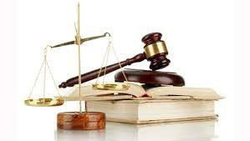
The Law of Ukraine "On the Security Service of Ukraine" stipulates the duties of its bodies, namely: to carry out intelligence and information-analytical work; carry out counterintelligence support measures for diplomatic missions, consular and other state institutions; detect, stop and solve crimes, the investigation of which is assigned to their competence; conduct inquiries and investigations in these cases, search for persons who are hiding in connection with the commission of the specified crimes; carry out counter-intelligence support of the defense complex, energy, transport, communication, as well as important objects of other branches of the economy; participate in the development and implementation of measures to protect state secrets; to provide assistance to border troops, internal affairs bodies, customs service in the fight against crime.
A separate body of the executive power in the field of security is the State Security Office of Ukraine, which, in accordance with the Law of Ukraine "On State Security of State Powers of Ukraine and Officials", is a special state law enforcement body subordinate to the President of Ukraine and under the control of the Verkhovna Rada of Ukraine.
State security of the state authorities of Ukraine and officials is a system of organizationallegal, regime, operational-investigative, engineering-technical and other measures, which are carried out by specially authorized state authorities in order to ensure the normal functioning of the state authorities of Ukraine, the safety of officials and objects defined by the Law "On State Protection of State Authorities of Ukraine and Officials".

